Slide 1
College Application Process
Do your research! - find out as much as possible about the college before you apply
Collegeboard, Naviance and college websites
Look at the college’s SAT/ACT/academic requirements to see if your are “in the zone” or need to retake SAT/ACT. (Certain majors may be more selective)
Look at the application online- ensure you know application deadlines and requirements (essays, letters of recommendations, supplemental forms)
Is it a “Self Report” school?

Slide 2
Application Process
Apply only to colleges which you are seriously considering (don’t waste resources)
If colleges need essays and recommendations, start on those now (may be limited)
Politely ask teachers well in advance. Send teachers recommender requests through Naviance.
Update your Bio/Resume’ in Naviance- teachers can access there

Slide 3
Transcript Release
Need parent signature (if under 18 years old) in order to release academic information and transcripts to colleges, military, NCAA and scholarship committees
All “official” transcripts must be sent from the school
Need 7 working days prior to deadline

Slide 4
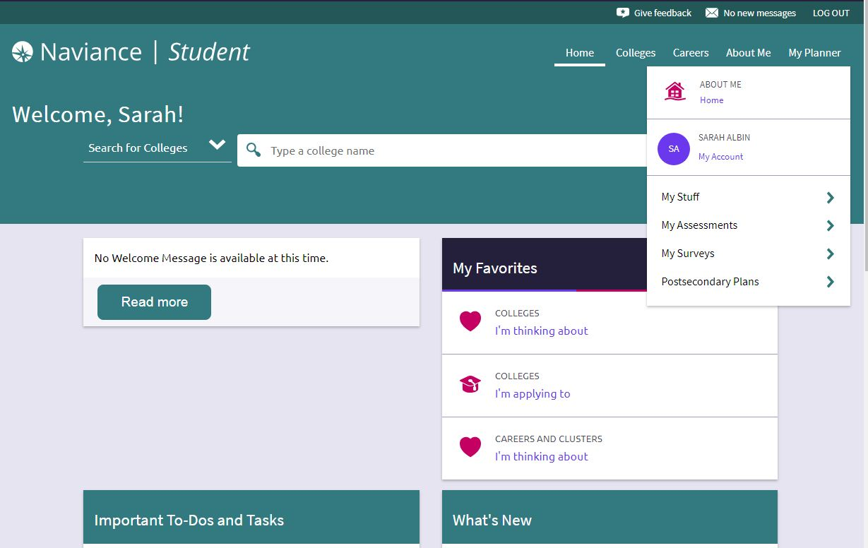
Navigate Naviance HOME page

Slide 5
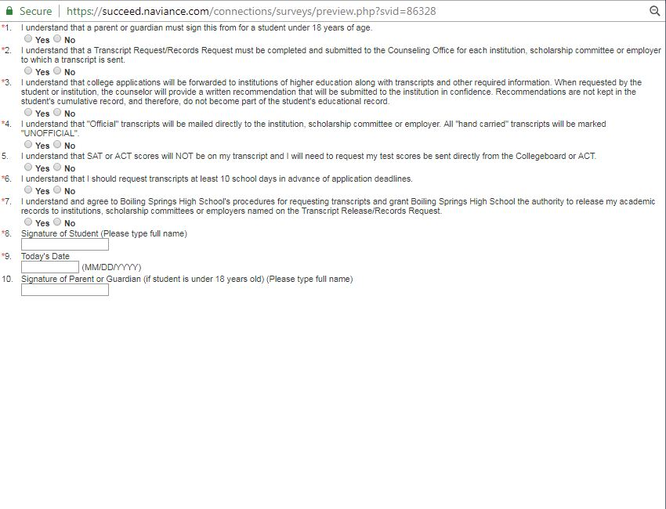
Naviance Transcript Release

Slide 6
Application Steps
Apply to the college (directly online to college’s admissions site or Common Application)
BSHS CEEB code: 390370
+ADD college(s) to Naviance under Colleges I’m Applying To:
Give Counseling Office AT LEAST 7 business days to prepare your transcript and upload to Naviance.
Follow up via Naviance and/or with the college to track process

Slide 7
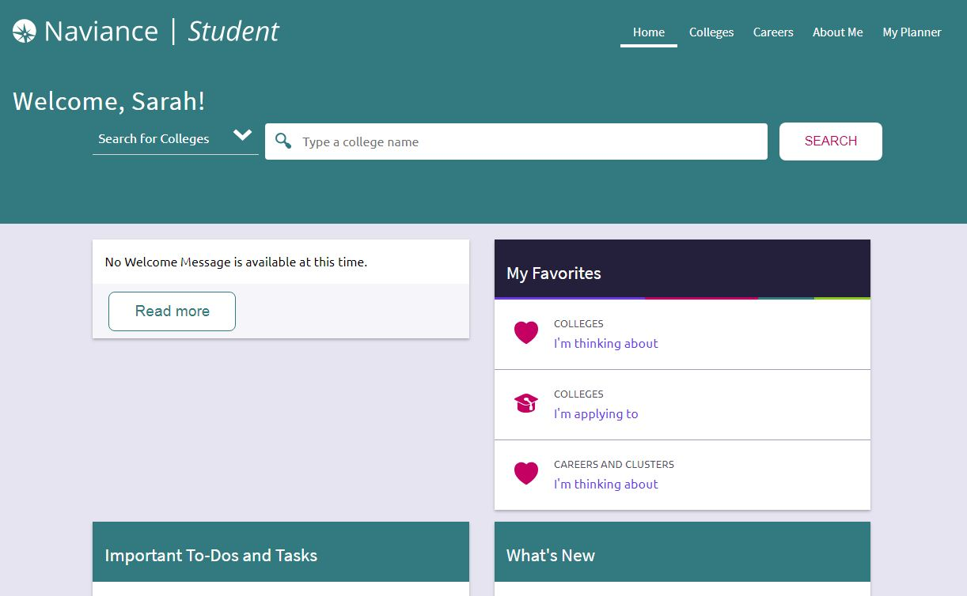
Add Colleges- 1

Slide 8
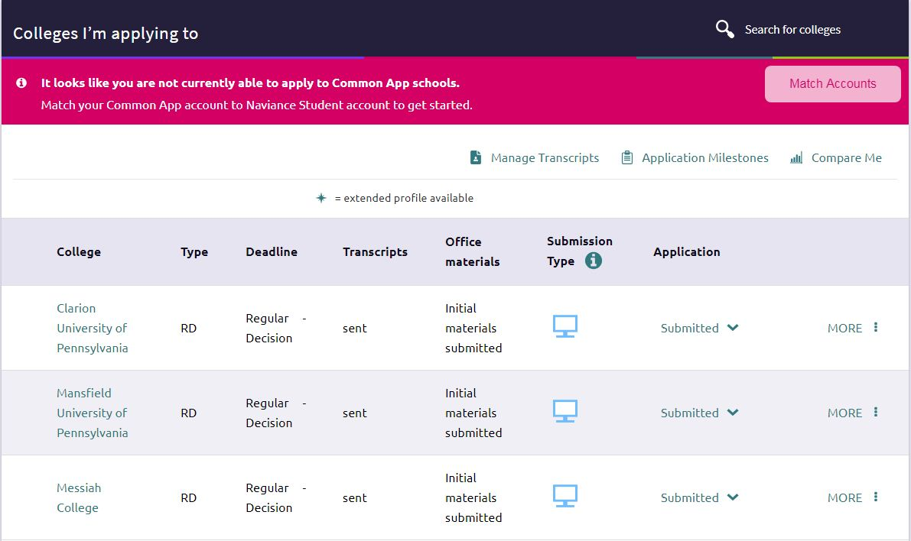
Add Colleges-2

Slide 9
Naviance/Common Application Process
Many colleges use it.
Easy and efficient when applying to several schools that use it.
Instantaneous upload/transmission
Less chance of mail being lost.

Slide 10
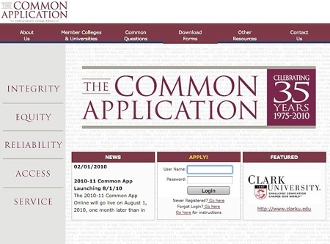
Common Application to Colleges

Slide 11
Senior Interviews
Sign up now
Discuss academic progress, credits toward graduation, career goals, transition after high school
In depth discussion about college application process, financial aid and scholarship search

Slide 12
Important E mail Addresses
Mr. McQuaig- hsm@smsd.us
Mrs. Graybill- lry@smsd.us

Slide 13
Scholarships/Financial Aid
Colleges are the main source of information
Boiling Springs Scholarship List
Financial Aid Info Night- October 21st- 6:30 pm

Slide 14
Questions
?

